Slide 1
Design & Analysis
of Algorithms
Lecture # 2
AHSAN HUMAYUN
ahsanhumayun.ah@gmail.com

Slide 2
In the Last Lecture
Definition
History

Slide 3
Today’s Agenda
Problem Solving
RAM
Selection Problem

Slide 4
Problem Solving
Programming is a process of problem solving
Problem solving techniques
Analyze the problem
Outline the problem requirements
Design steps (algorithm) to solve the problem
Algorithm:
Step-by-step problem-solving process
Solution achieved in finite amount of time

Slide 5
Problem Solving Process
Step 1 - Analyze the problem
Outline the problem and its requirements
Design steps (algorithm) to solve the problem
Step 2 - Implement the algorithm
Implement the algorithm in code
Verify that the algorithm works
Step 3 - Maintenance
Use and modify the program if the problem domain changes

Slide 6
Important Properties of Algorithms
Correct
always returns the desired output for all legal instances of the problem.
Unambiguous
Precise
Efficient
Can be measured in terms of
Time
Space
Time tends to be more important

Slide 7
Expressing Algorithms
English description
Pseudo-code
High-level programming language
More
precise
More easily expressed

Slide 8
How fast will your program run?
The running time of your program will depend upon:
The algorithm
The input
Your implementation of the algorithm in a programming language
The compiler you use
The OS on your computer
Your computer hardware
Maybe other things: temperature outside; other programs on your computer; …
Our Motivation: analyze the running time of an algorithm

Slide 9
Criterion for analyzing
We will measure algorithm in terms of the amount of computation recourses that algorithm requires:
Running time
Memory used
We should be agree on some criterion

Slide 10
Mathematical Model of computation
Analysis should be independent
Unlike programs, algorithms are to be understand primarily by people not machines
This gives us flexibility
To perform our analysis we will assume a hypothetical machine

Slide 11
Random Access Machine (RAM)
Single Process
Instruction are executed one by one (not parallelism)
Infinitely large memory

Slide 12
Design And Analysis
In order to understand design and analysis procedure we will do an example

Slide 13
Selection Problem
Suppose you want to purchase a Laptop
You want to pick fastest Laptop
But fast Laptops are expensive
You cannot decide which one is more important price or speed

Slide 14
Selection Problem
Definitely do not want a Laptop if there is a another Laptop that is both fast and cheaper
We say that fast cheap Laptops “dominates” the slow expensive
So given a list of Laptops we want those that are not dominated by the other

Slide 15
Criterion for selection
Two criterion for selection:
Speed
Price

Slide 16
Mathematical Model
P is in two dimensional space and its coordinates are P=(p.x , p.y)
(x,y)
x is speed of Laptop
y is negation of price
We can say about y
High value of y mean cheap Laptop and low y means Laptop is expensive
A point p is said to be dominated by a point q if p.x <= q.x and p.y <= q.y
In an array of points (Laptops) P={p₁,p₂,p₃,….,p_{n}} a maximal point is not dominated by any other point

Slide 17
Example
Given a set of point P={p₁,p₂,p₃,….,p_{n} } output the maximal points
Those points of P such that p_{i} is not dominated by any other point

Slide 18
Brute-Force Method
Simplest design strategy
Straightforward approach to solving a problem, usually directly based on the problem’s statement
Results in an algorithm that can be improved with a modest amount of time.

Slide 19
Brute-Force Algorithm
Maximal(int n, Point p[1……n])
for i = 1 to n
maximal = true
for j = 1 to n
if( i != j ) and (p[i].x <= p [j]. x) and (p [i] .y <= p [j].y)
maximal = false;
break;
if (maximal == true)
then output p [i].x , p[i]. y

Slide 20
Running Time Analysis
We can observe that:
The running time depends upon the input size.
Different input of the same size may result different time

Slide 21
Running Time Analysis
Count the number of steps of the pseudo code that are executed
Or count the number of times an element of p is accessed
Or number of comparisons that are performed

Slide 22
Analysis of selection Problem
Input size is n
We will count how many number of steps

Slide 23
Brute-Force Algorithm
Maximal(int n, Point p[1……n])
for i = 1 to n
maximal = true
for j = 1 to n
if( i != j ) and (p[i].x <= p [j]. x) and (p [i] .y <= p [j].y)
maximal = false;
break;
if (maximal == true)
output p [i].x , p[i]. y
n times
1 time
Worst Case Analysis
n times
5 times
2 times

Slide 24
Analysis of selection Problem
The outer loop runs n times
For each iteration. The inner loop runs n times in the worst case
P is accessed four times in the if statement
The output statement accesses p 2 times

Slide 25
Maximal(int n, Point p[1……n])
for i = 1 to n
maximal = true
for j = 1 to n
if( i != j ) and (p[i].x <= p [j]. x) and (p [i] .y <= p [j].y)
maximal = false;
break;
if (maximal == true)
output p [i].x , p[i]. y
n times
1 time
n times
5 times
2 times

Slide 26
Analysis of selection Problem
In the worst case every point is maximal so every point is output
Worst-case time is:

Slide 27
Analysis of selection Problem
Asymptotic Notation

Slide 28
Analysis of Selection Problem
T(n) is Asymptotically equivalent to n²

Slide 29
Analysis of selection Problem
Suppose n=50 and
We use a computer whose speed is 10000000 instructions per second
Then this computer requires

Slide 30
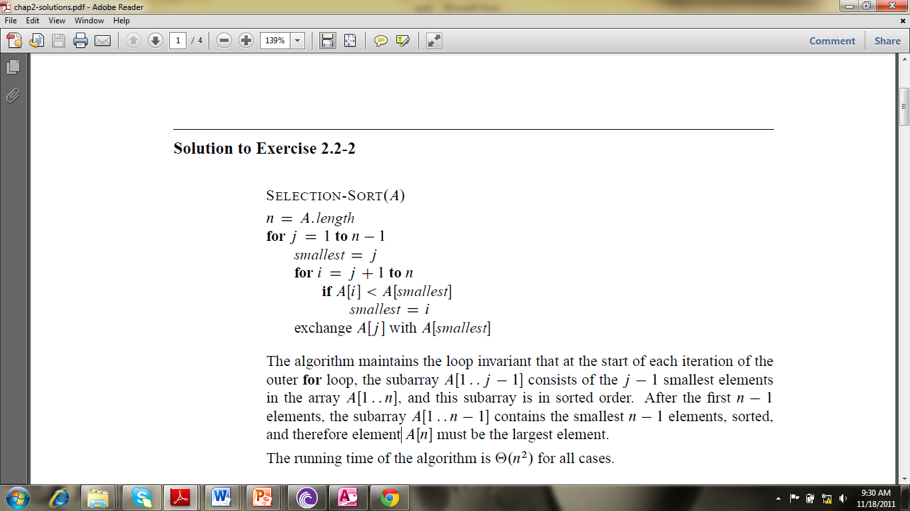
Example 1
// Array Display
for j =1 to n
display A[j]

Slide 31
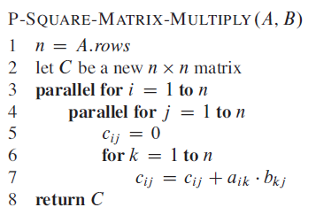
Example 2

